Slide 1

WAY TO ENTERPRISE
Advanced Java
VTI ACADEMY
Author: duy.nguyenngoc1@vti.com.vn
March 2020

Slide 2
Agenda
Global Exception
Basic Authentication
Log4j
Assignments
Copyright © VTI Academy All Rights Reserved

Slide 3
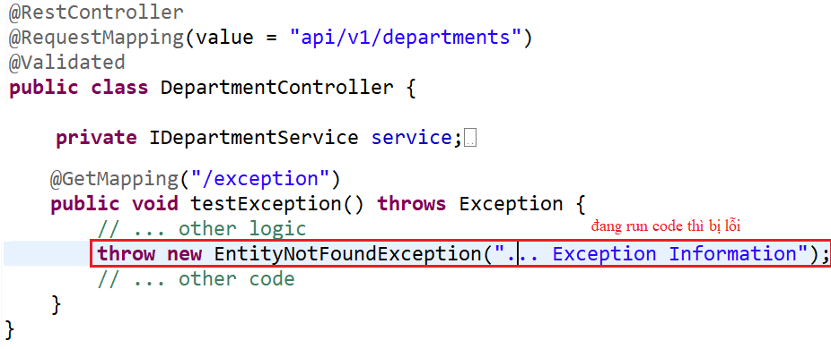
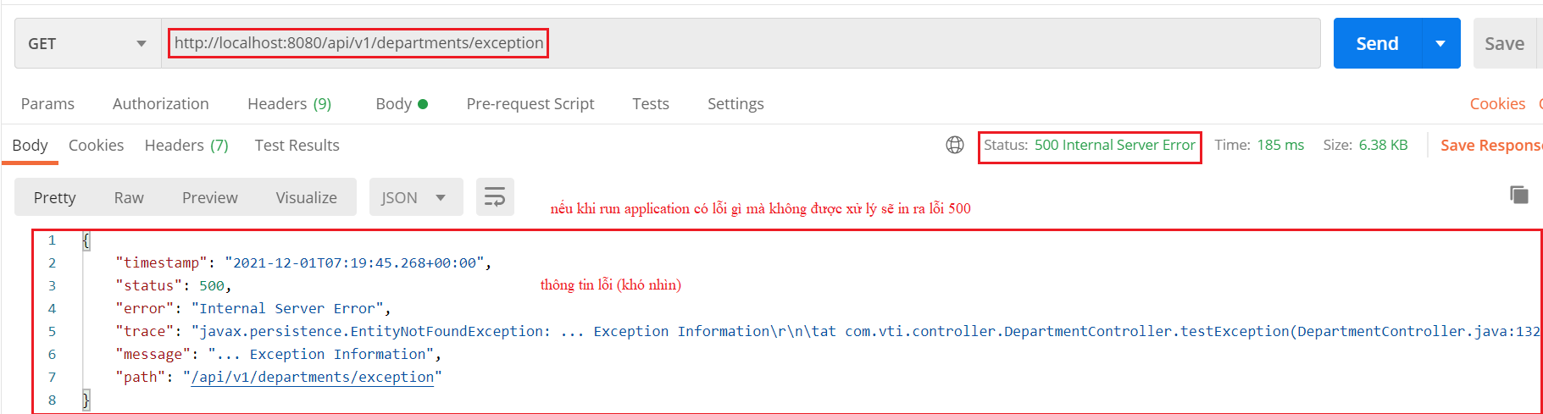
Global Exception
Example 1:
Local Exception
Error

Slide 4
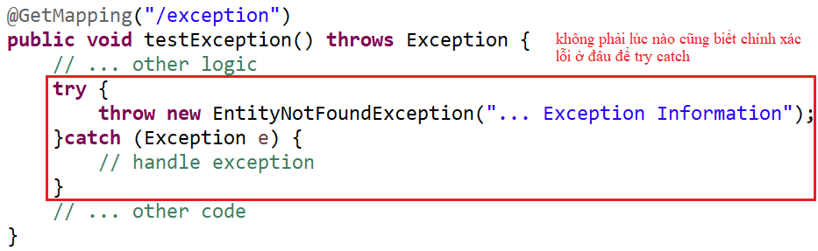
Global Exception
Handling Error

Slide 5
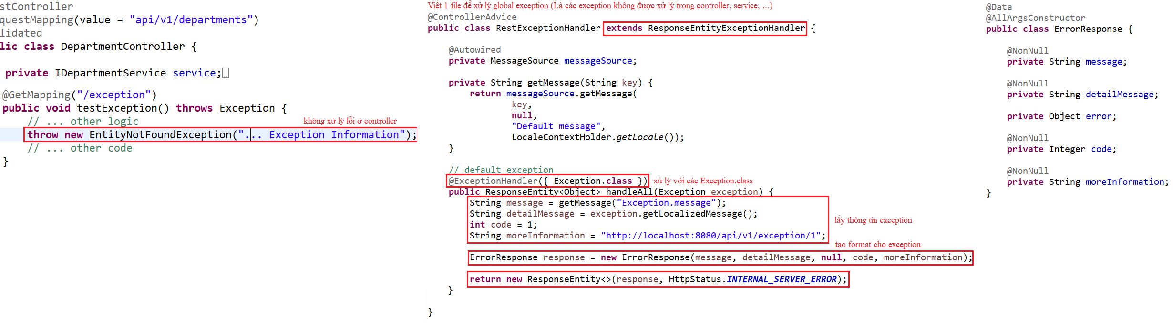
Global Exception
Global Exception

Slide 6
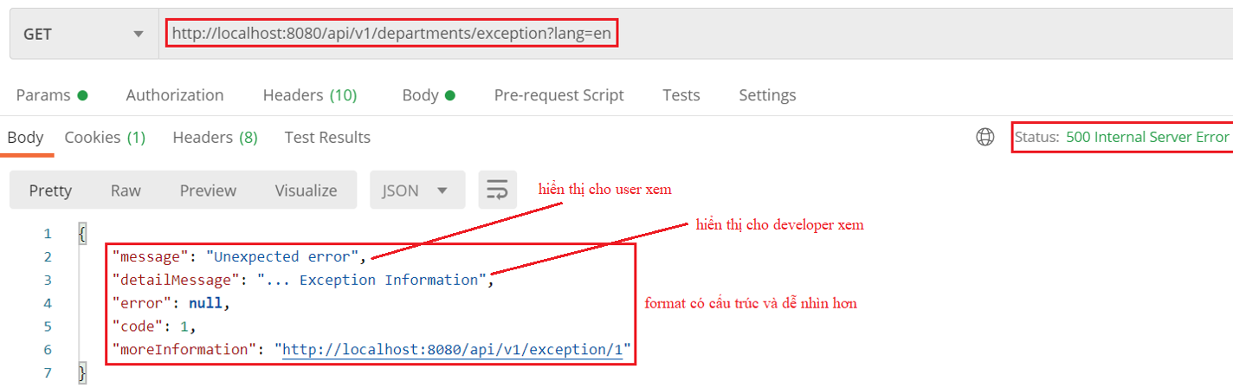
Global Exception

Slide 7
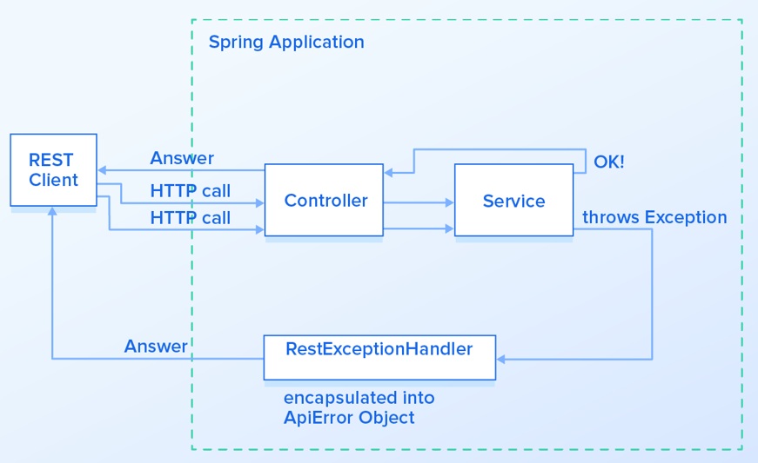
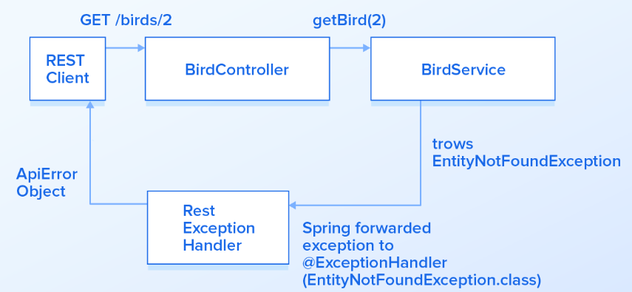
Global Exception

Slide 8
Testing System Assignments
Self-practice

Slide 9
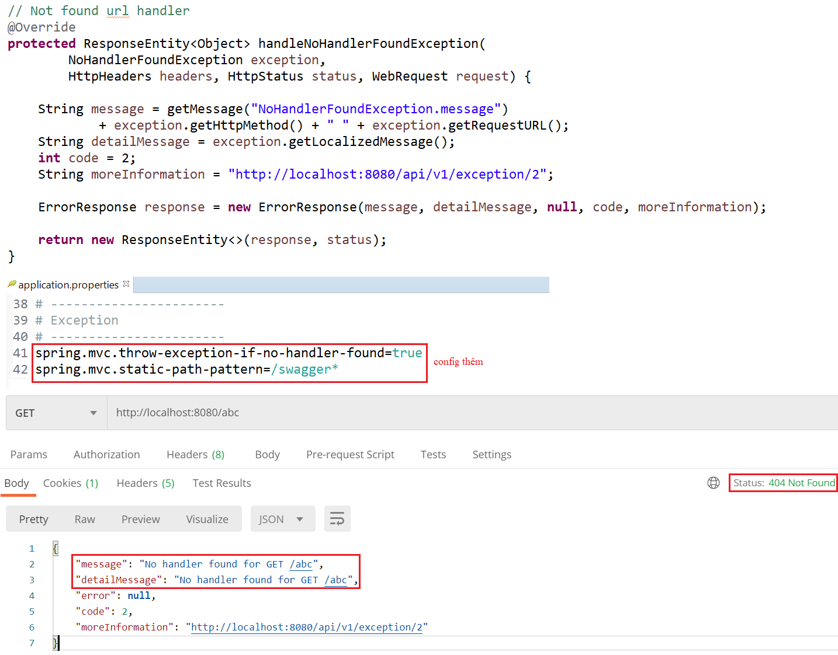
Global Exception
Example 2: Template
NoHandlerFoundException

Slide 10
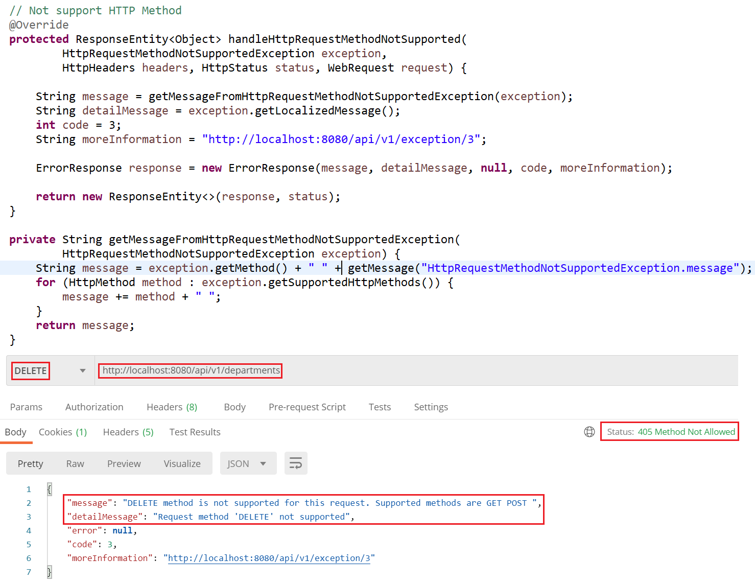
Global Exception
HttpRequestMethodNotSupported

Slide 11
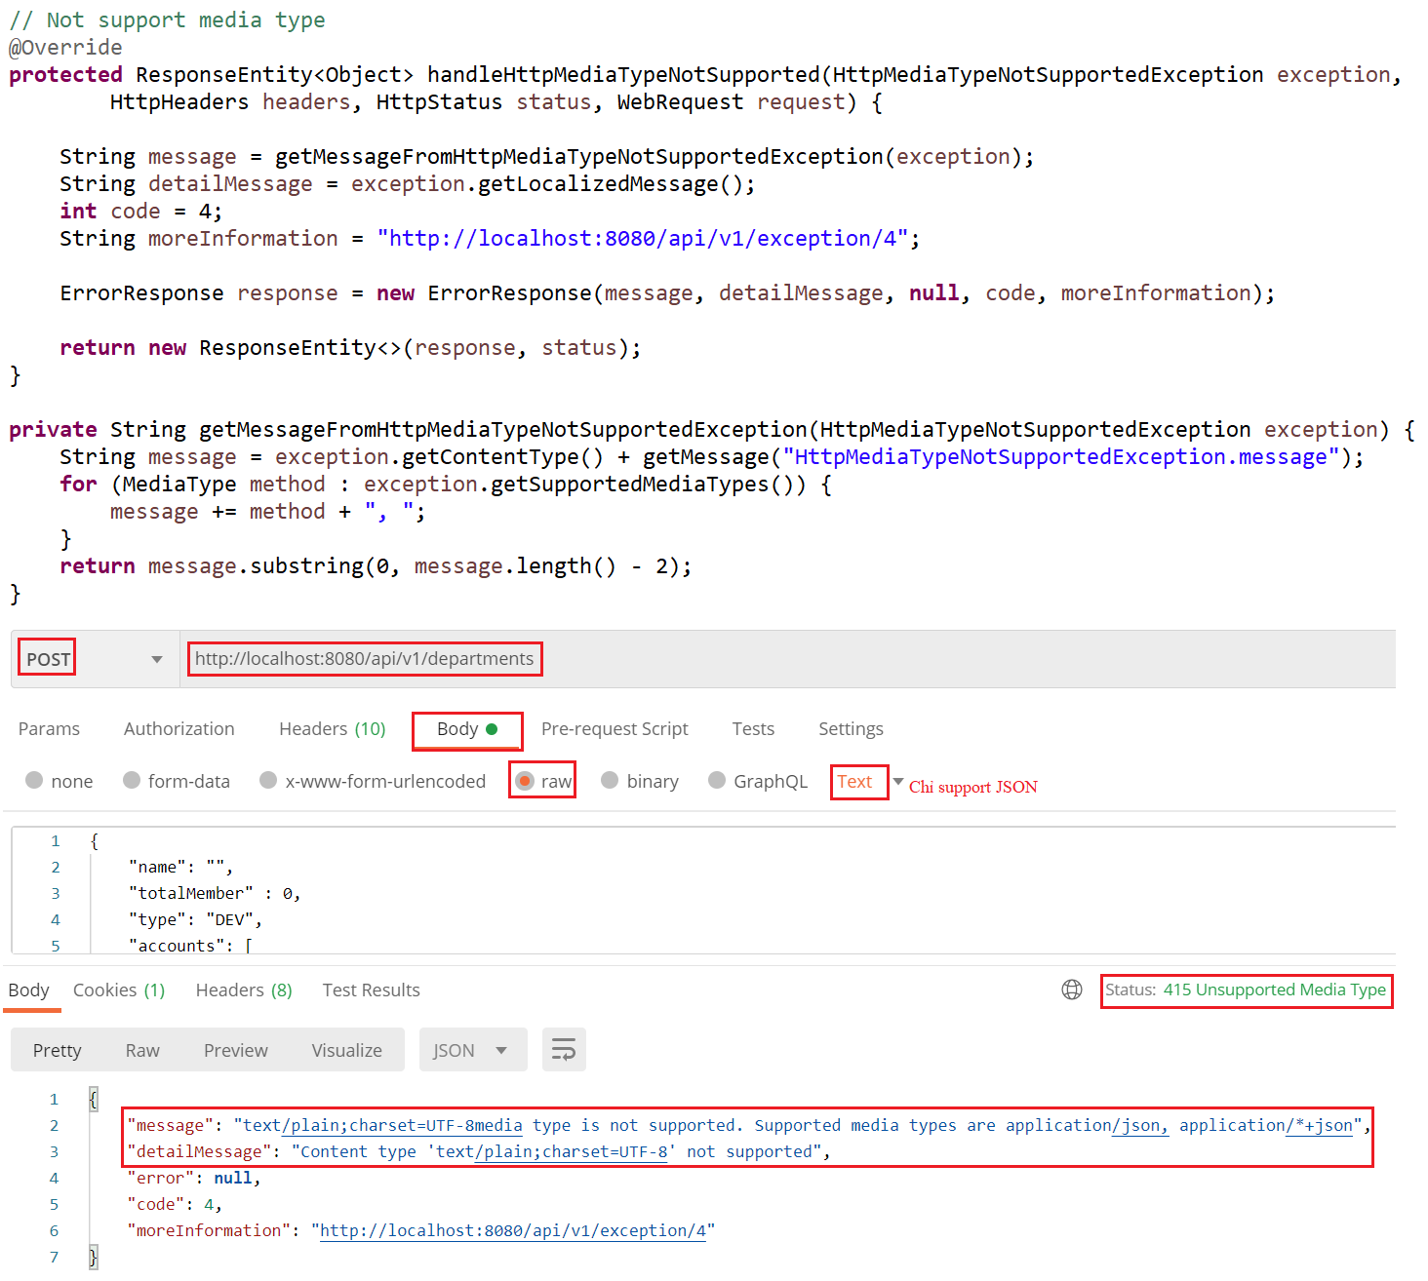
Global Exception
HttpMediaTypeNotSupported

Slide 12
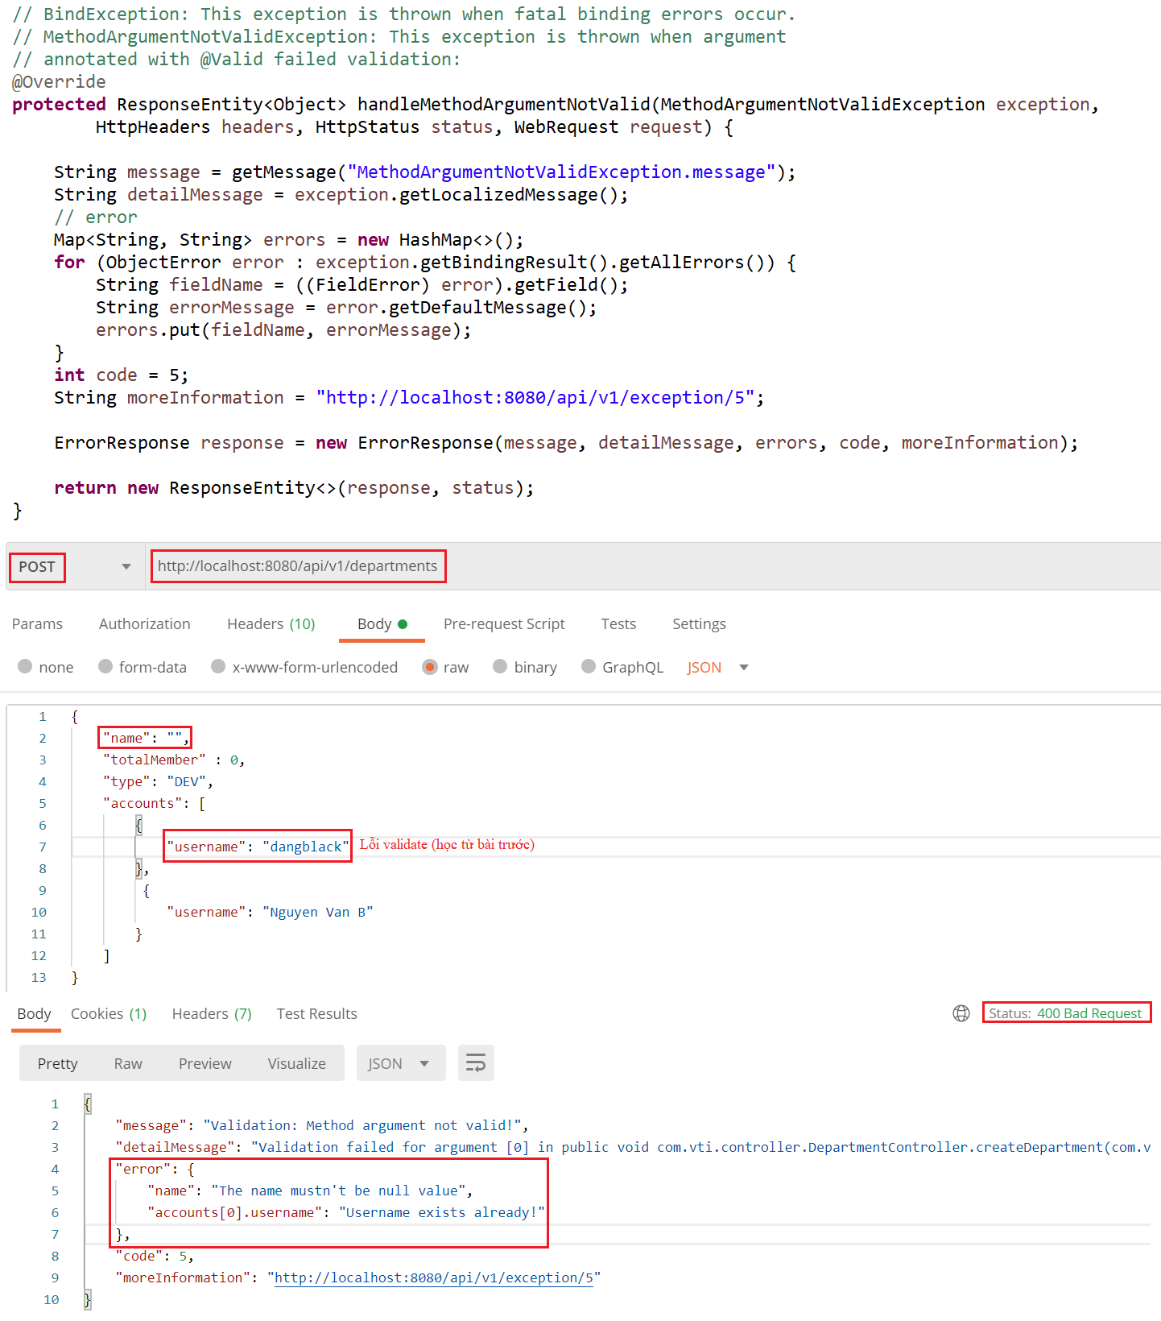
Global Exception
MethodArgumentNotValid

Slide 13
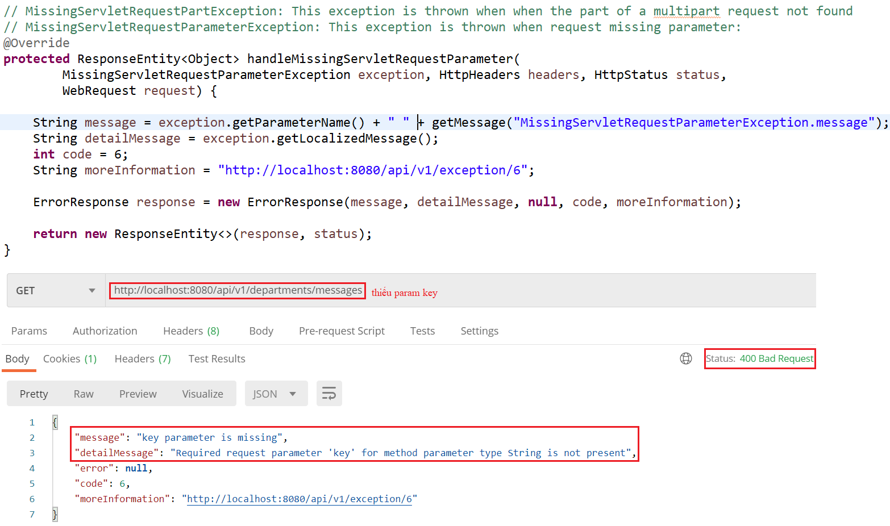
Global Exception
MissingServletRequestParameter

Slide 14
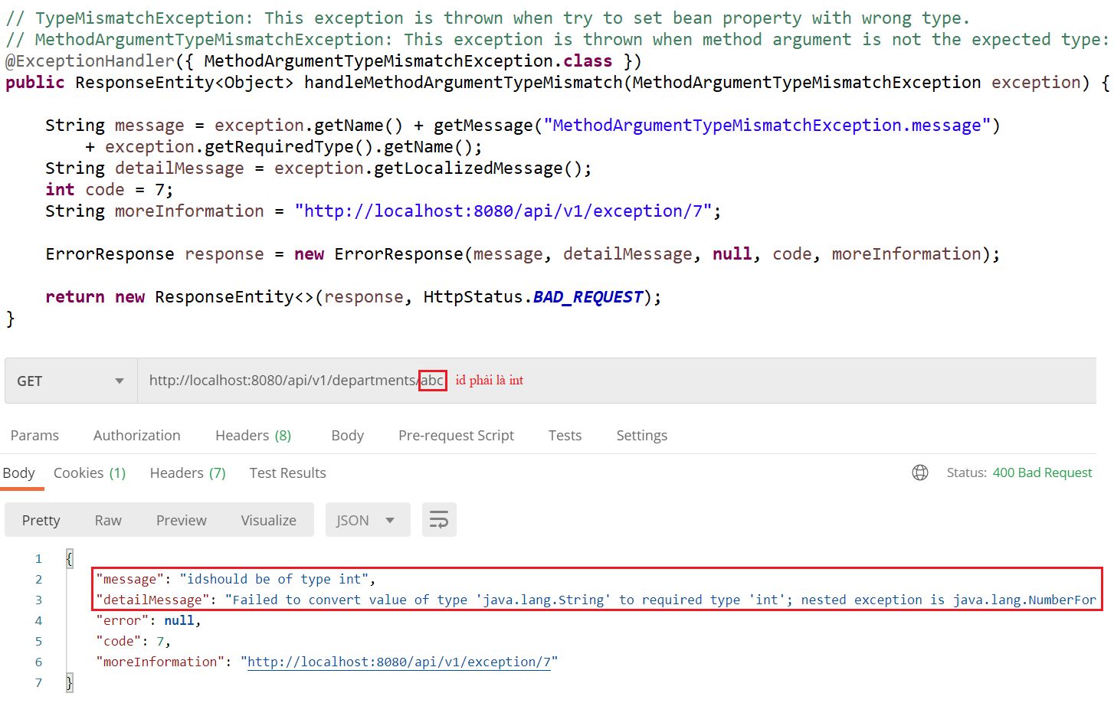
Global Exception
MethodArgumentTypeMismatch

Slide 15
Testing System Assignments
Self-practice

Slide 16
Global Exception
Reference:
https://www.baeldung.com/global-error-handler-in-a-spring-rest-api
https://www.toptal.com/java/spring-boot-rest-api-error-handling

Slide 17
Spring Security
Authentication & Authorization
Authentication
Basic Authentication (Current Lesson)
JWT (Next Lesson)
Oauth 2 (Next Lesson)
...

Slide 18
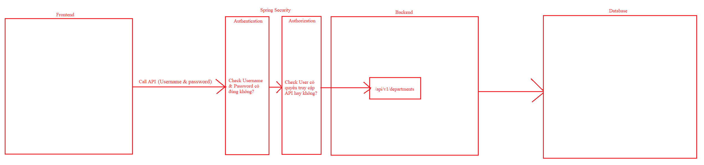
Spring Security

Slide 19
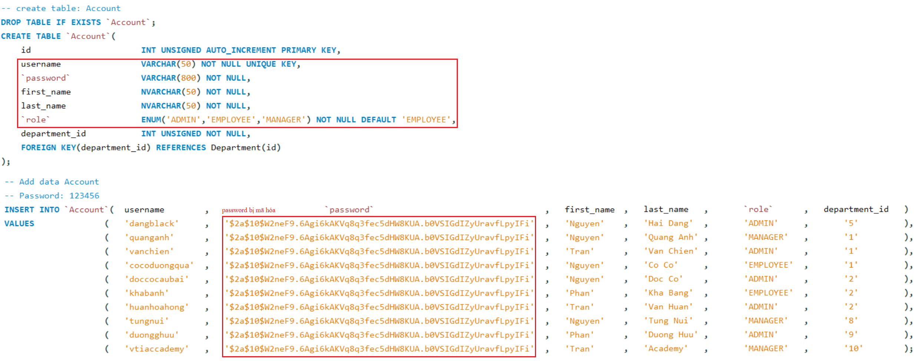
Basic Authentication
Example 1: Authentication
Database

Slide 20
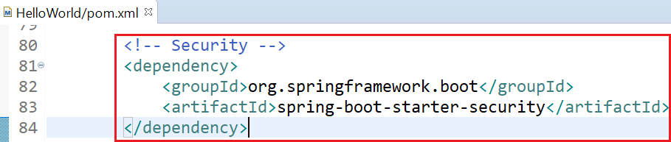
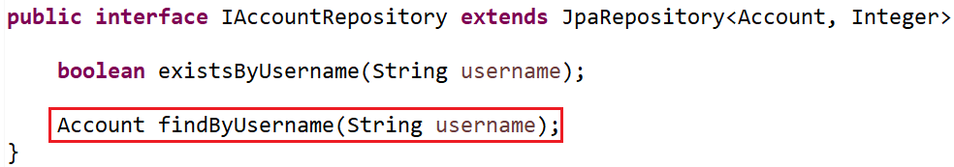
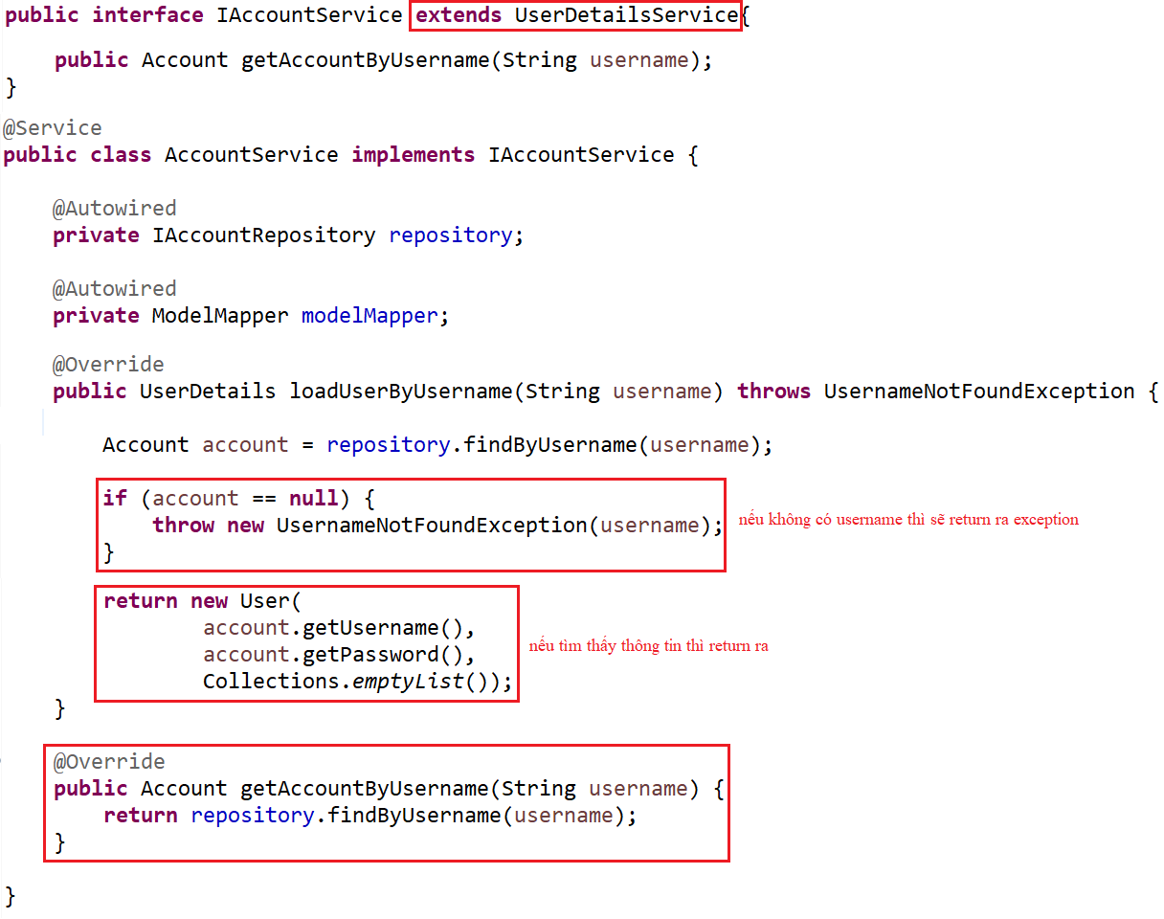
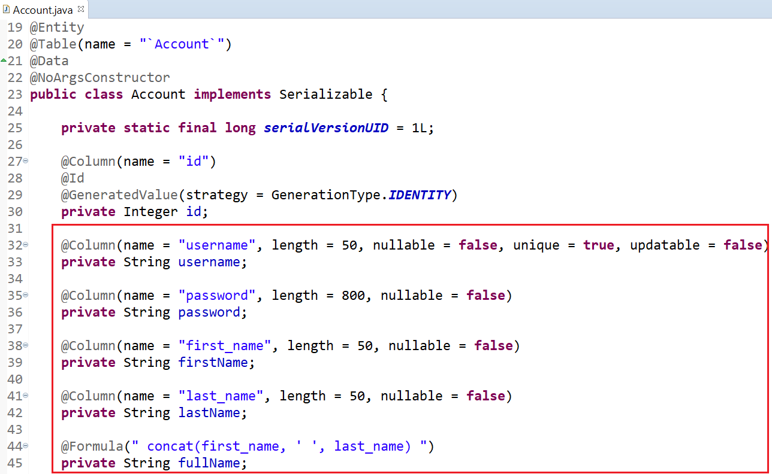
Basic Authentication
pom.xml
Repository
Entity
Service

Slide 21
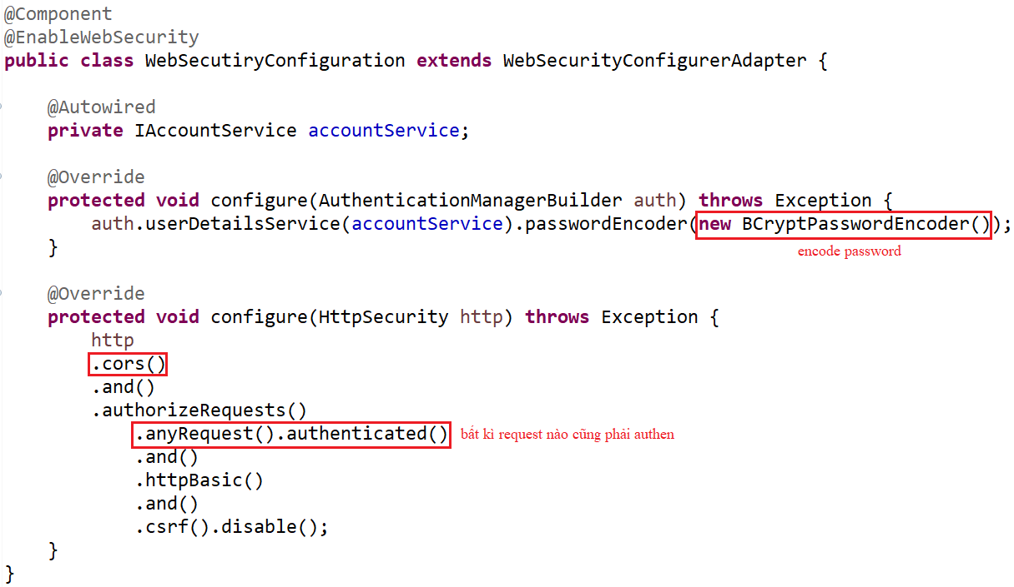
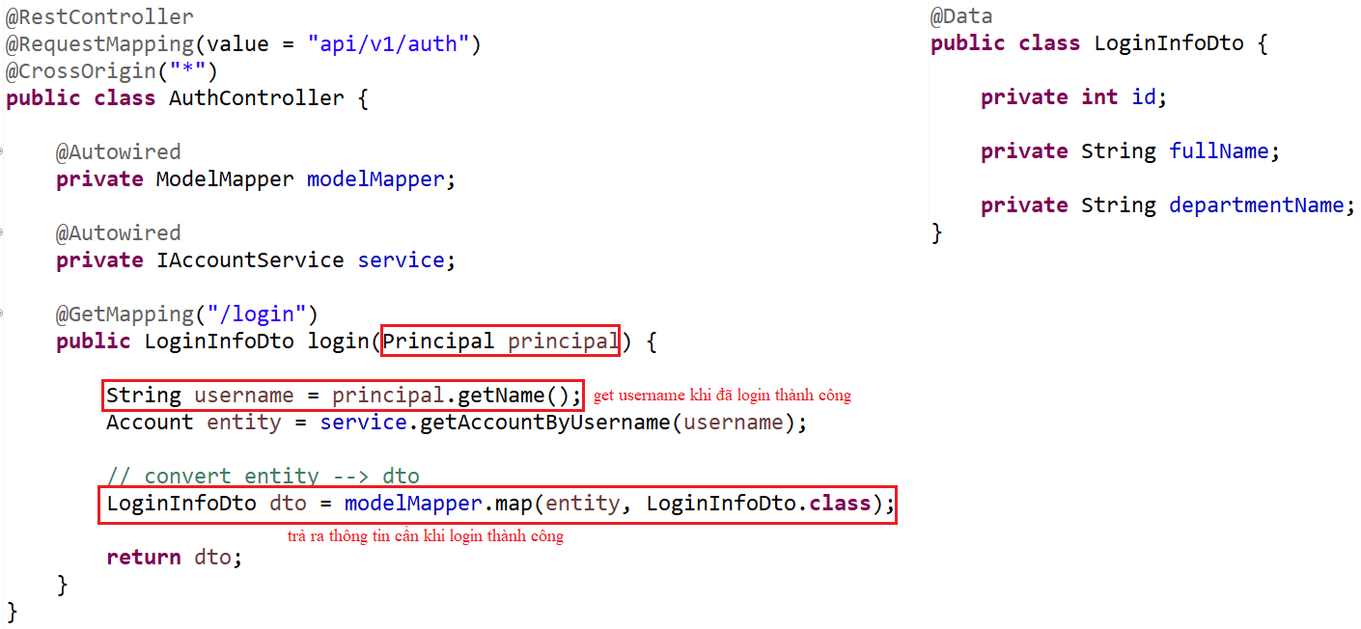
Basic Authentication
Controller
Security Config File

Slide 22
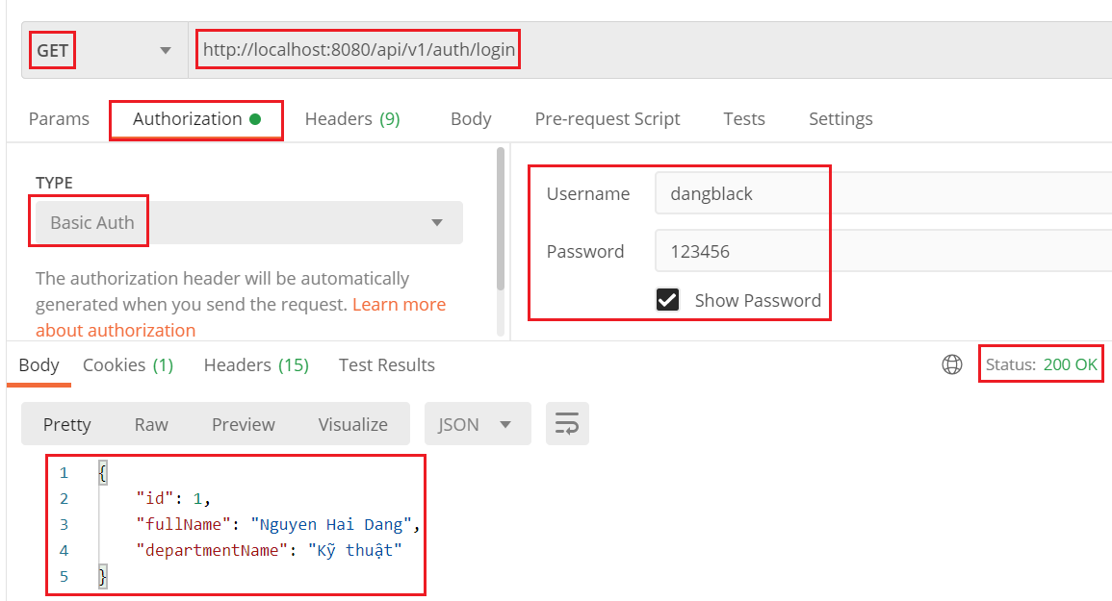
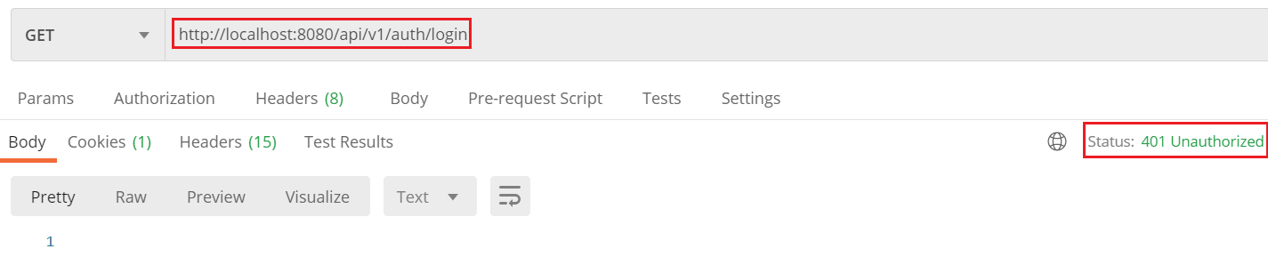
Basic Authentication

Slide 23
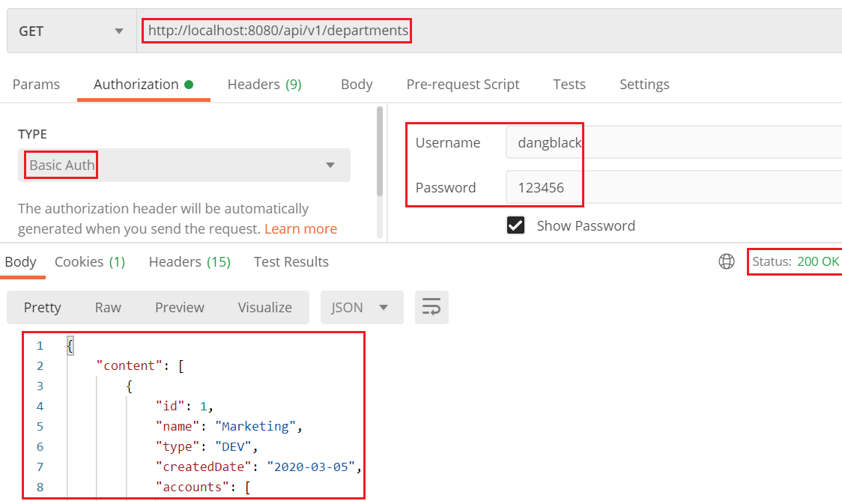
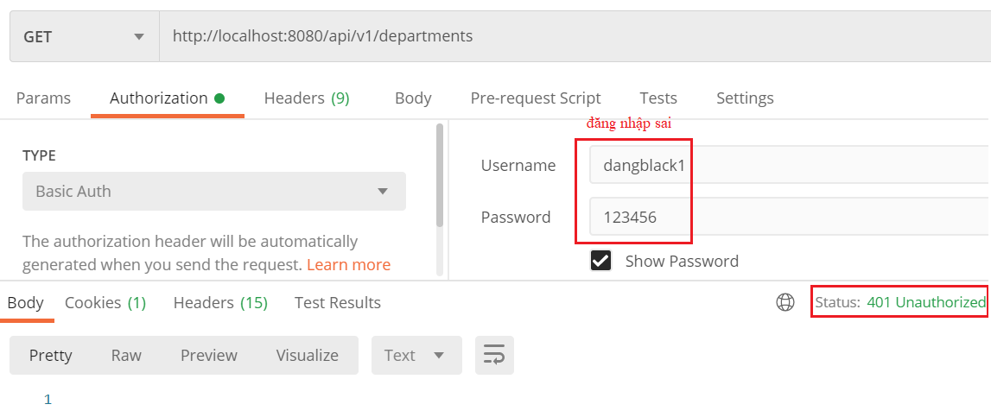
Basic Authentication

Slide 24
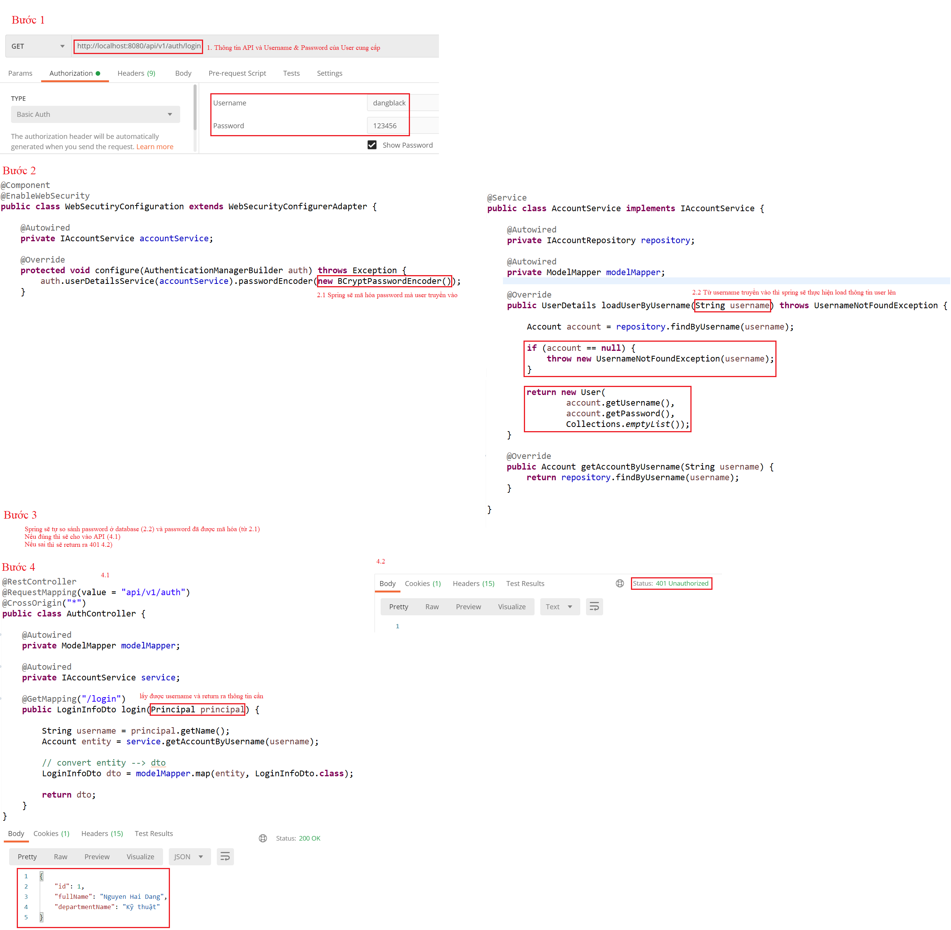
Basic Authentication
Explain:

Slide 25
Testing System Assignments
Self-practice

Slide 26
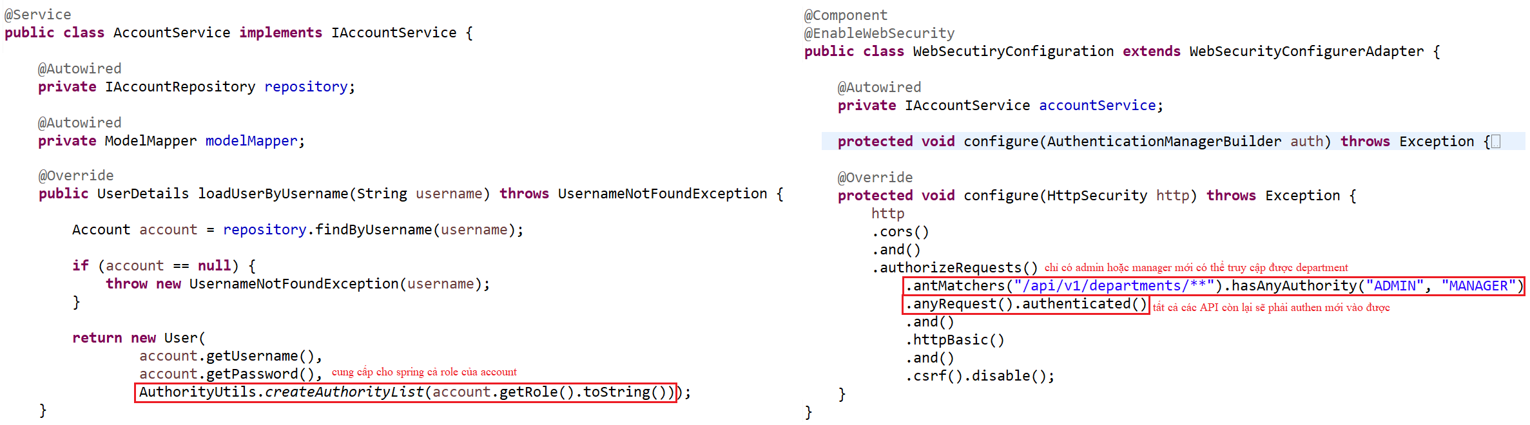
Basic Authentication
Example 2: Authorization
Service
Configuration

Slide 27
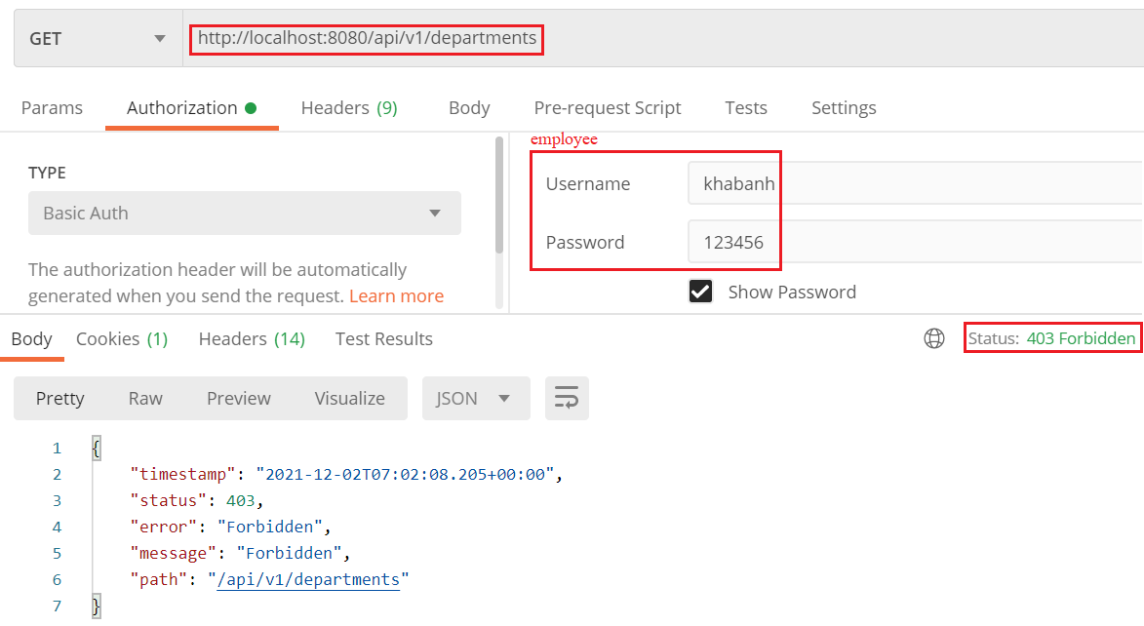
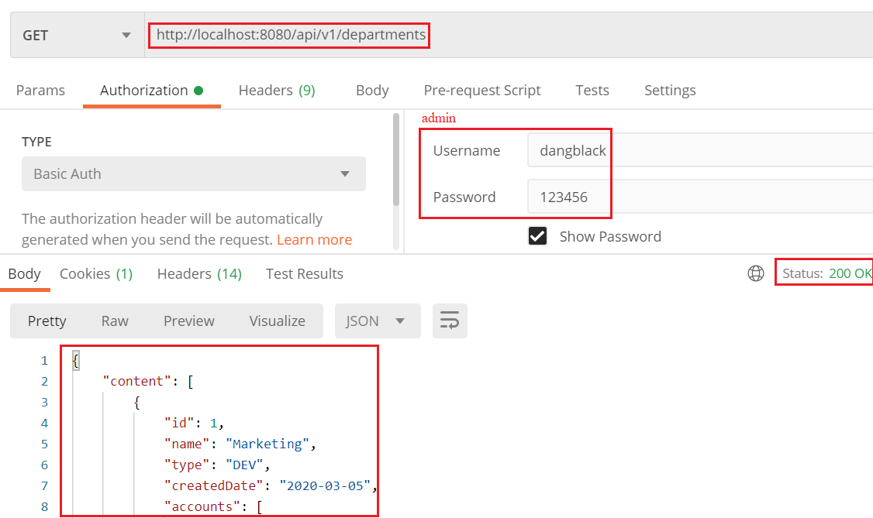
Basic Authentication
Test

Slide 28
Testing System Assignments
Self-practice

Slide 29
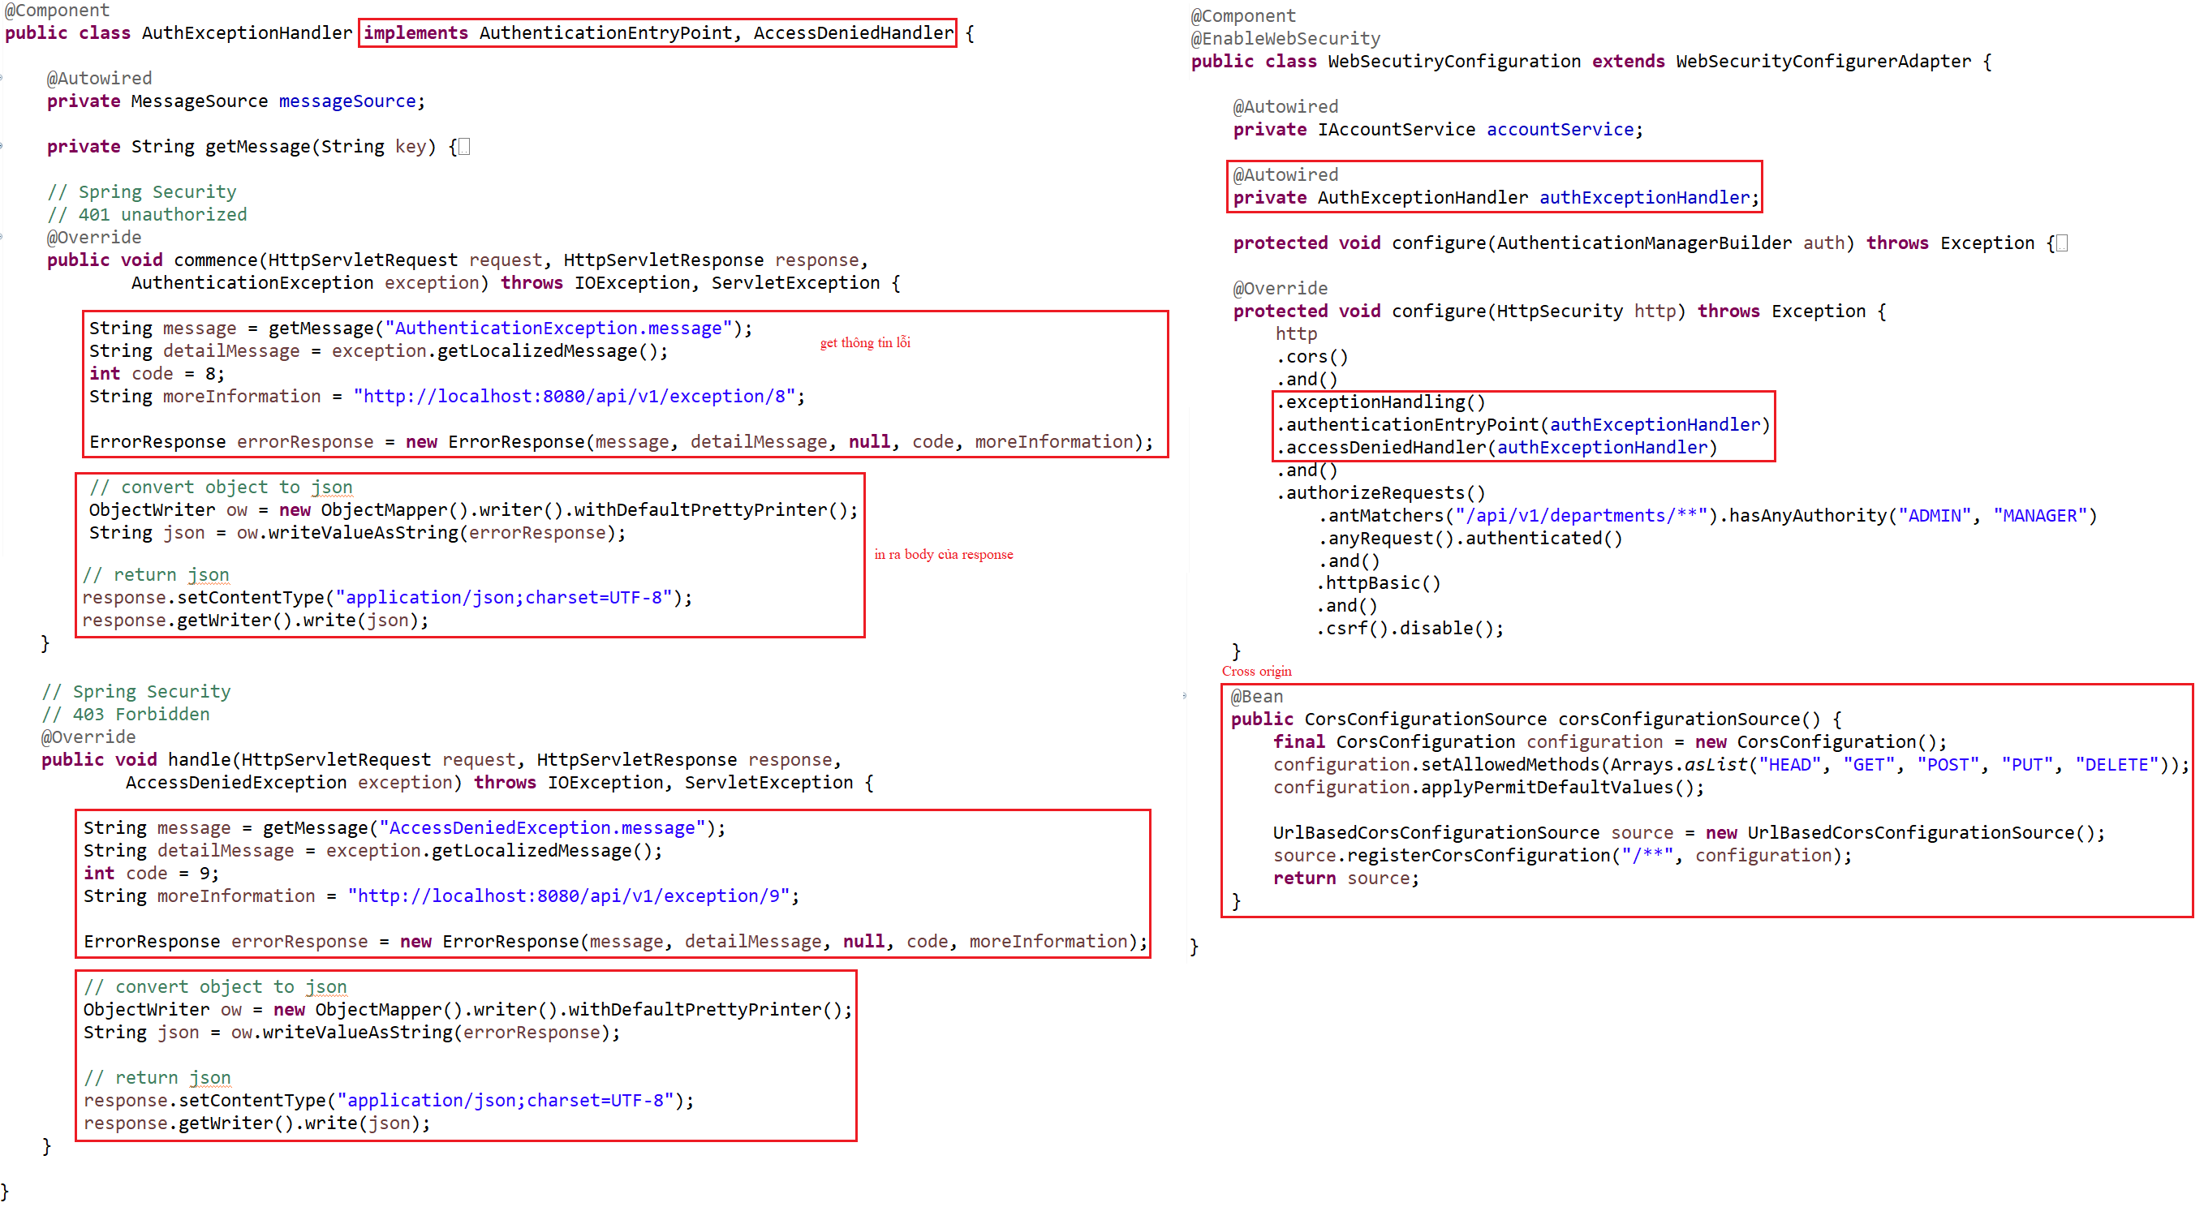
Basic Authentication
Example 3: Cross Origin & Exception

Slide 30
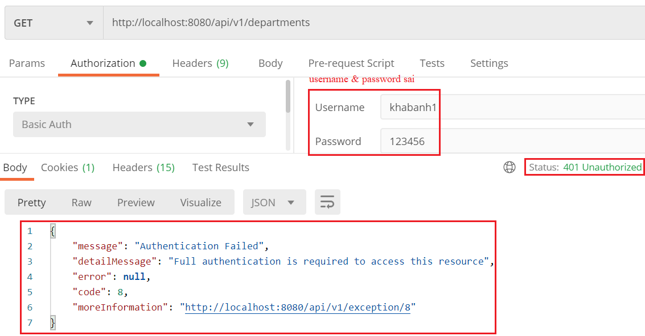
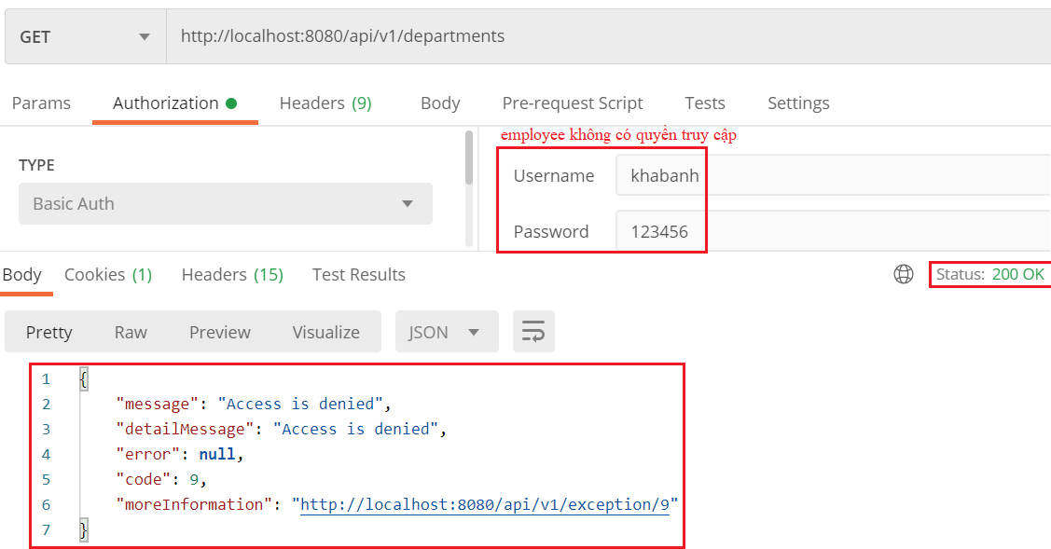
Basic Authentication
Test

Slide 31
Testing System Assignments
Self-practice

Slide 32
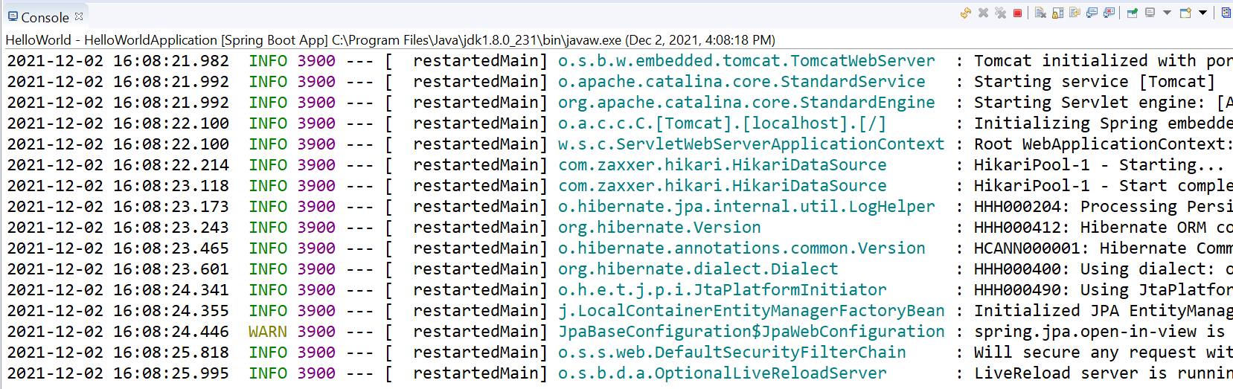
Log4j
Using to print or save information

Slide 33
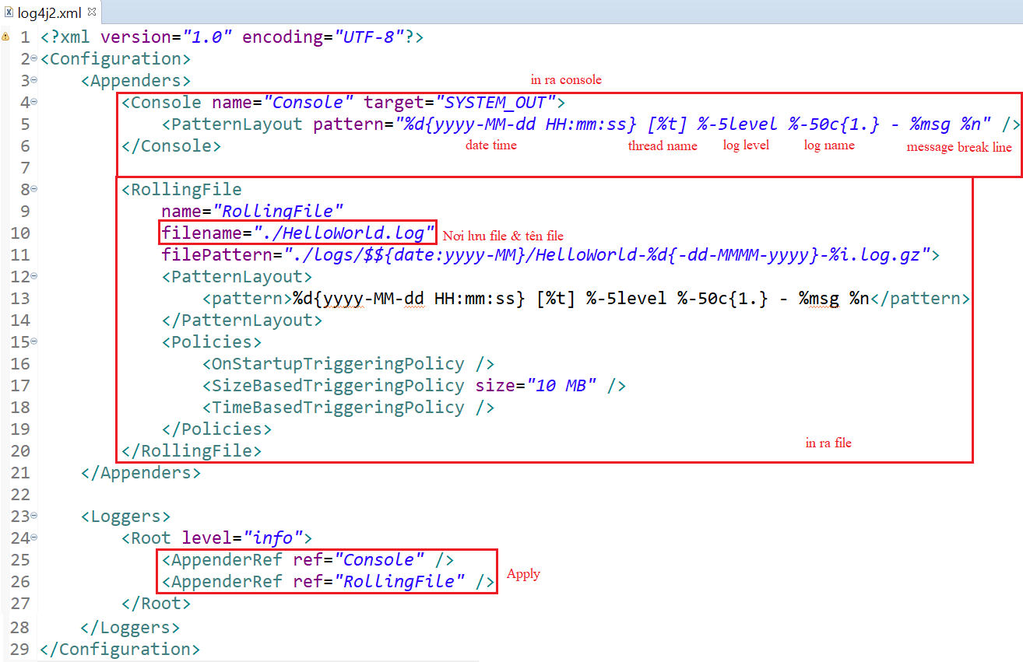
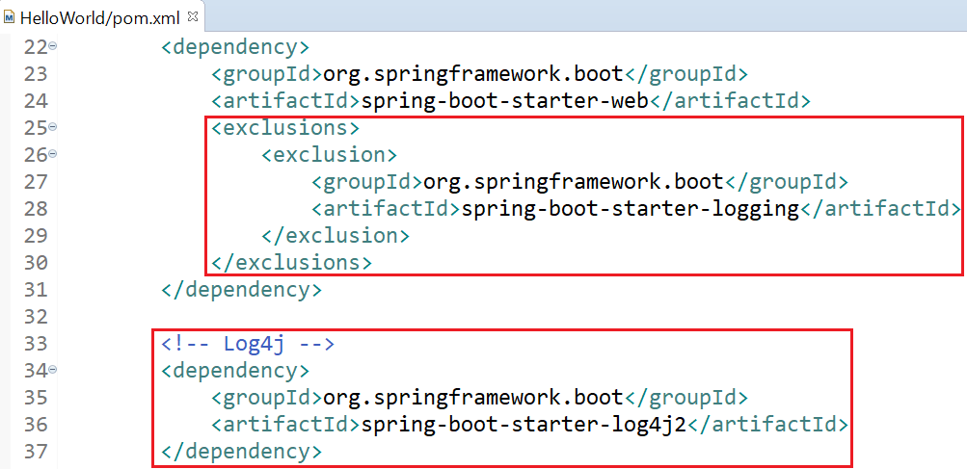
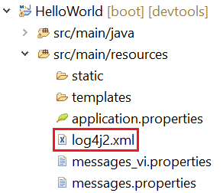
Log4j
Example 1: Save log
pom.xml
Log4j config file

Slide 34
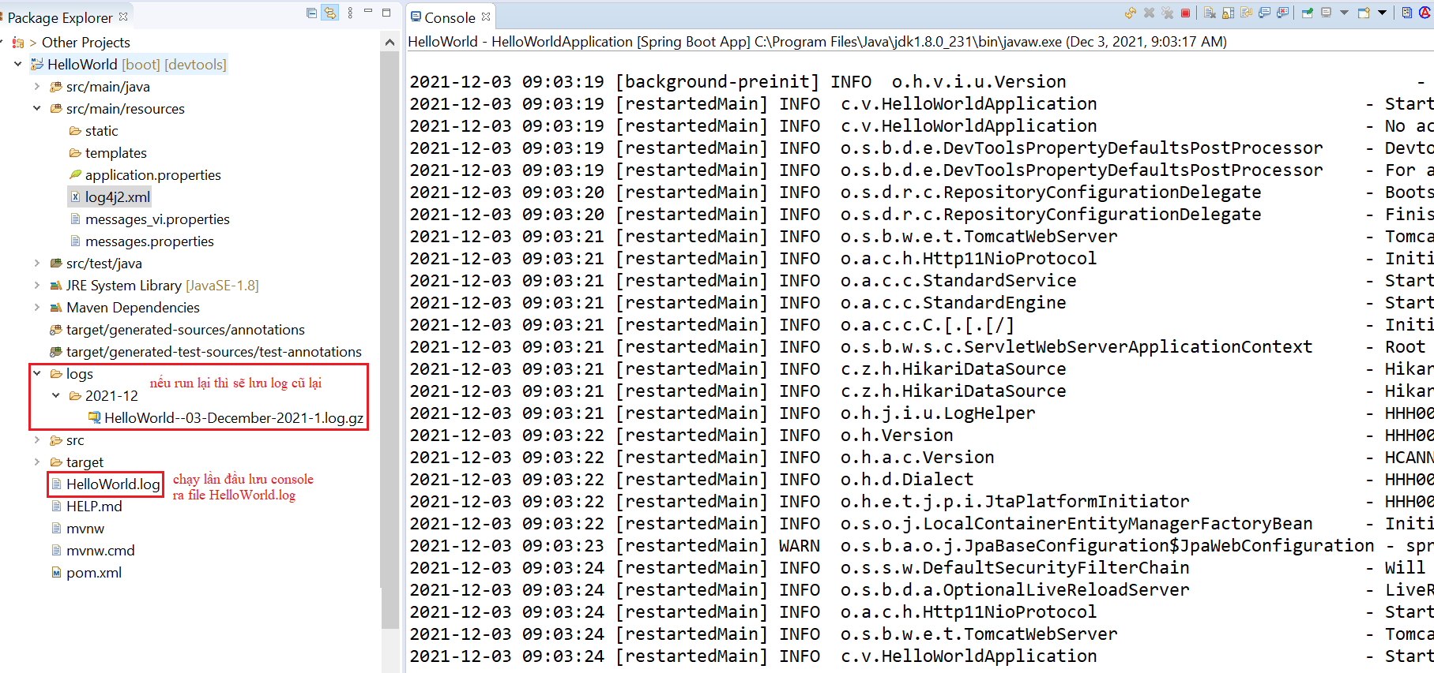
Log4j

Slide 35
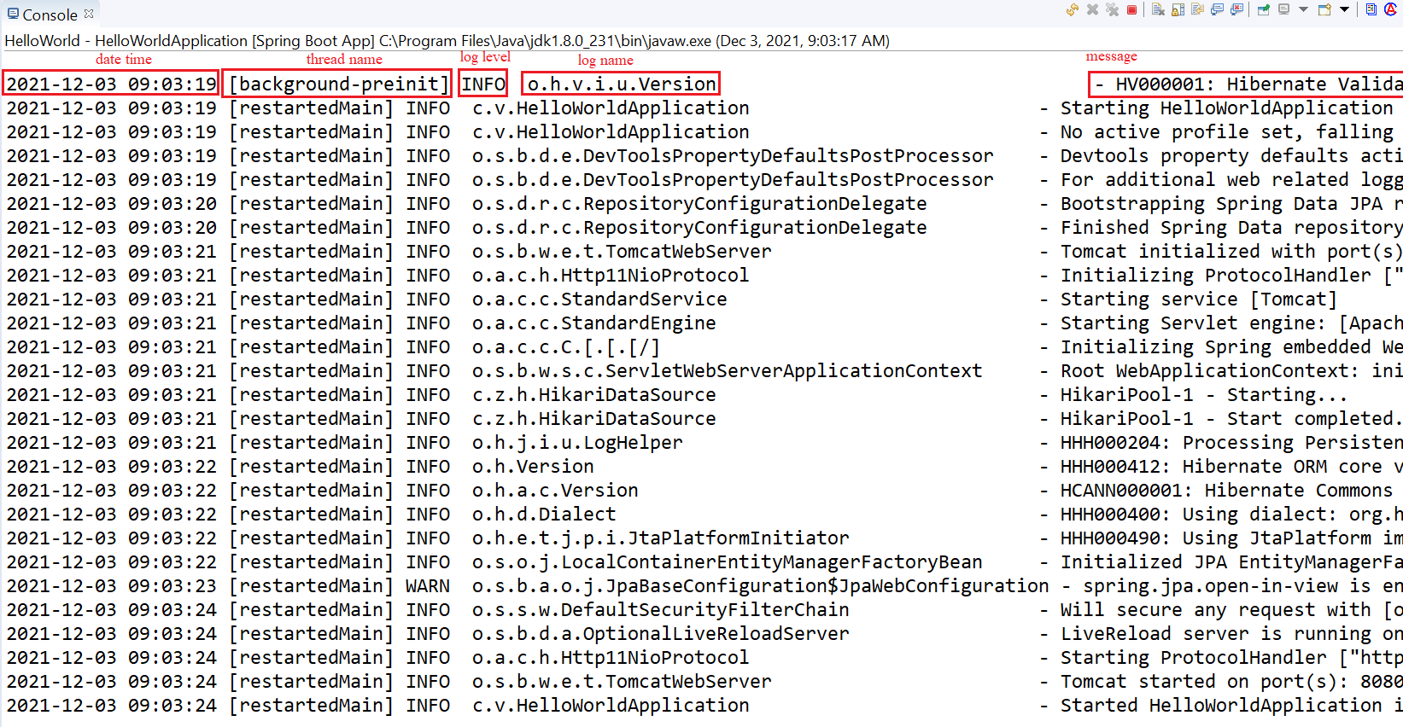
Log4j

Slide 36
Testing System Assignments
Self-practice

Slide 37
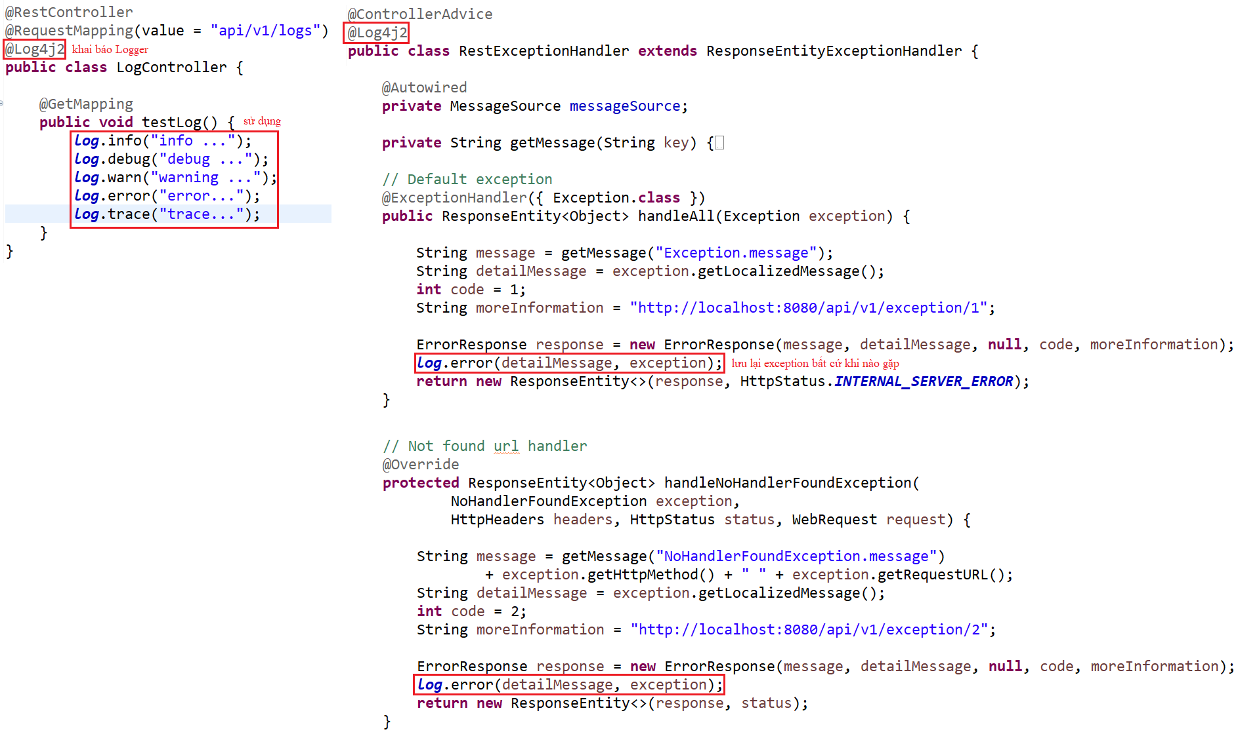
Log4j
Example 2: log level

Slide 38
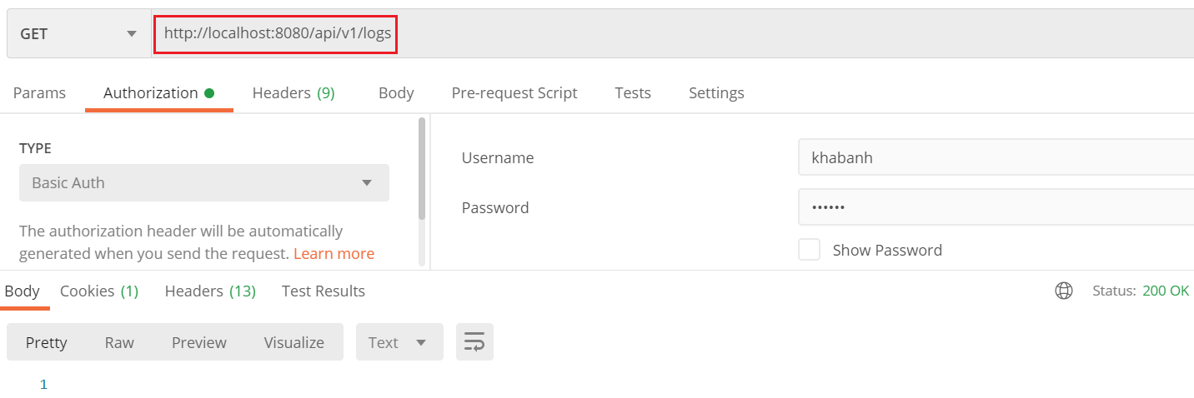
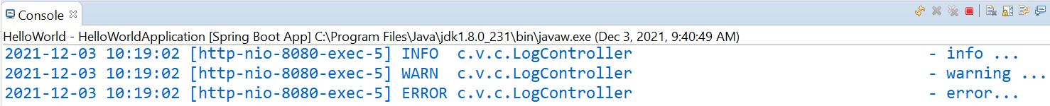
Log4j
Mode: info, debug, warn, error, trace, ...

Slide 39
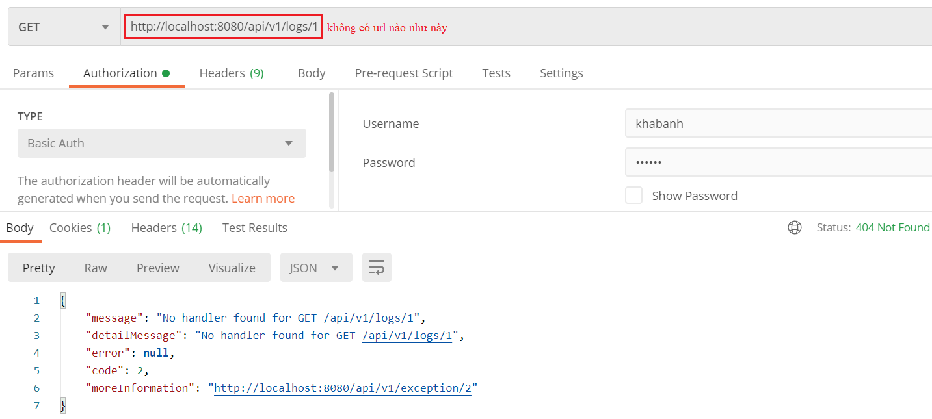
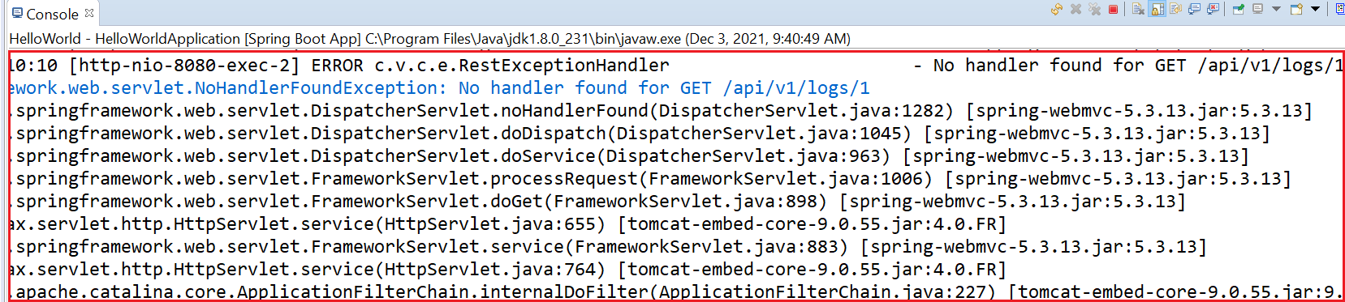
Log4j

Slide 40
Log4j
Reference:
https://www.youtube.com/watch?v=S9USRSEyWU0
https://www.baeldung.com/spring-boot-logging

Slide 41
Testing System Assignments
Self-practice

Slide 42
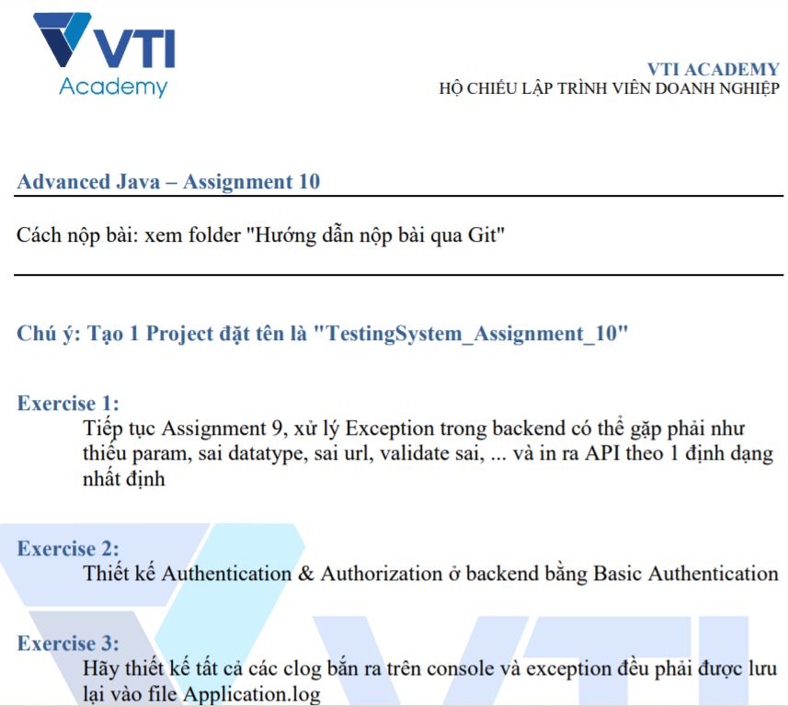
Testing System Assignments

Slide 43
Reference
https://www.baeldung.com
https://spring.io/projects/spring-boot
https://spring.io/guides#getting-started-guides

Slide 44
Q & A
Copyright © VTI Academy All Rights Reserved

